Slide 1




Festive Season
with VDO.AI

Slide 2
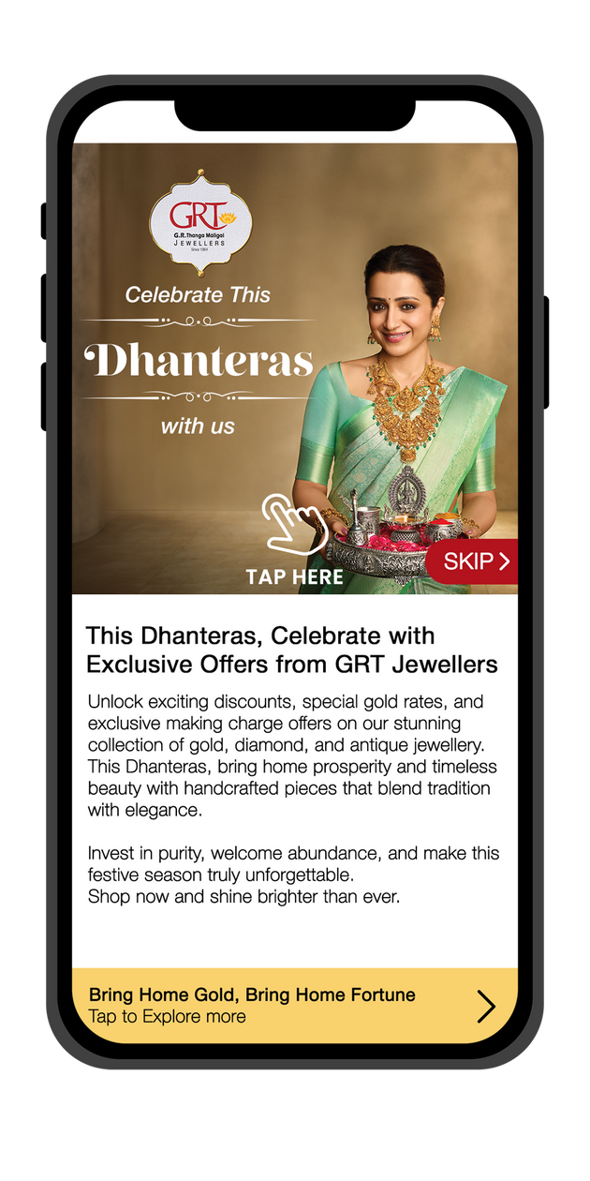



Festive Media Landscape in 2024
TYOHAAR KA RUSH
13%
5 to 6%
$14 Billion
Spends from Tier‑2 cities
Spends per
Shopper
Gross Merchandise Value, ↑ 12% Y-O-Y
CTV
OLV/
Advanced Display
TV
16% of total ad spend
55% of total ad spend
29% of total ad spend
₹500-800 CPM
High-Intent Targeting, Action - Driven Formats
₹340-400 CPM
Premium Placements, Innovative Formats
Lack of accurate measurement framework

Slide 3

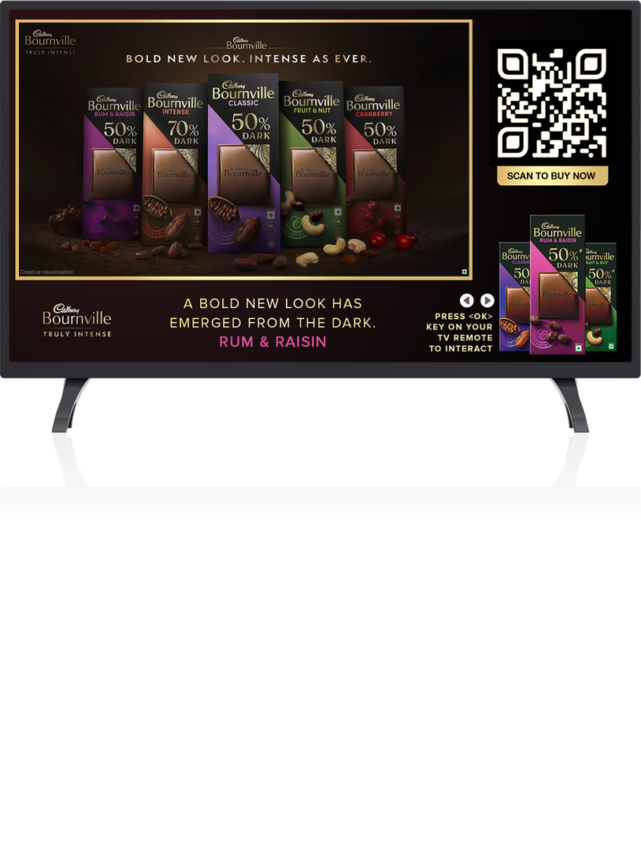

Festive Is Visual & Video Owns The Scroll
The Real Festive Multiplier
Big CTV Screens = Big Emotions + Bigger Impact
VIDEO WALI DIWALI
Full Funnel Attainment: From Mass Reach To Measurable Results
Video Drives The Discovery Journey
Storytelling Meets Smart Delivery

Slide 4















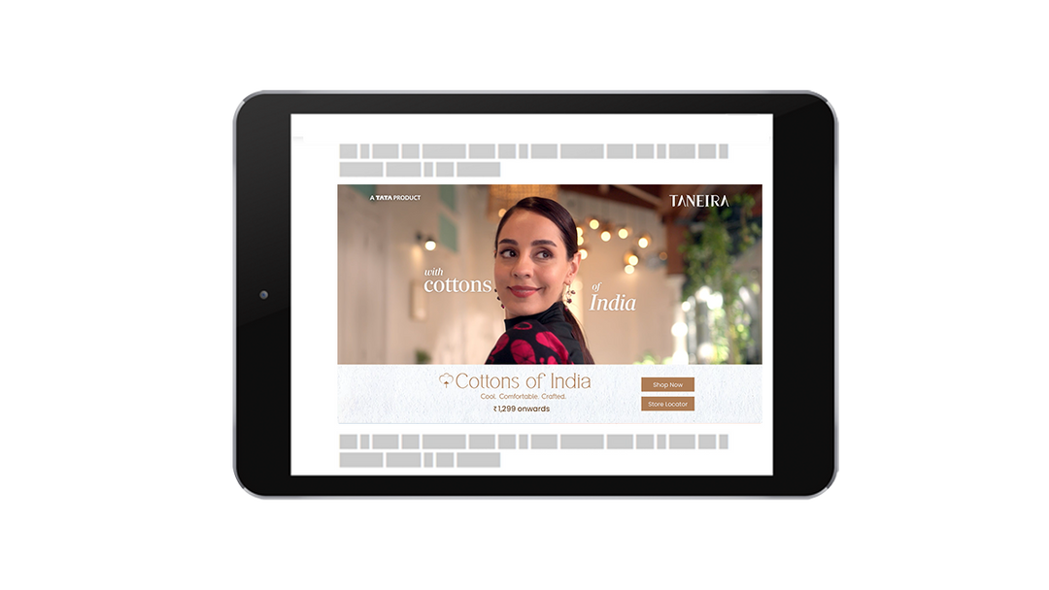










Festive Creative Tech Stack
TV Remote
Generative AI
Geo Location
Gyroscope
Speech Activation
Weather API
Sports Score API
Stock Market API
Motion Sensor
Parallax scroll
YOUR FESTIVE FORMAT FIX
3d Cube
Shake
Animation
Scratch
Augmented Reality
Trivia Quiz
Games
Add To Calendar
Countdown
Chat Bot
Expandable
Carousel Gallery
Touch Input
QR Code
360° Viewer

Slide 5
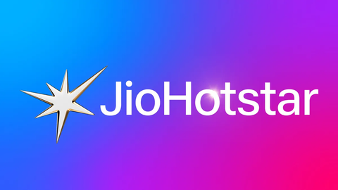









Our Premium Direct Supply
3.5 Mins
Average Play Time
70%
Higher Banner Viewability
INVENTORY KA VIP ZONE
Placed #1 as per leading DSPs
98%
Average VCR
41%
Increased Engagement
8/10 Largest Media Houses run on VDO.AI
Spread across 350+Billion Ad Units

Slide 6
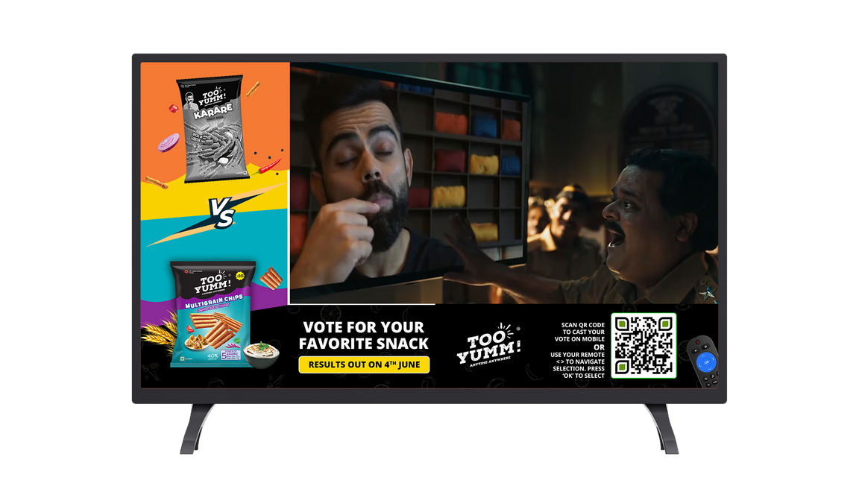

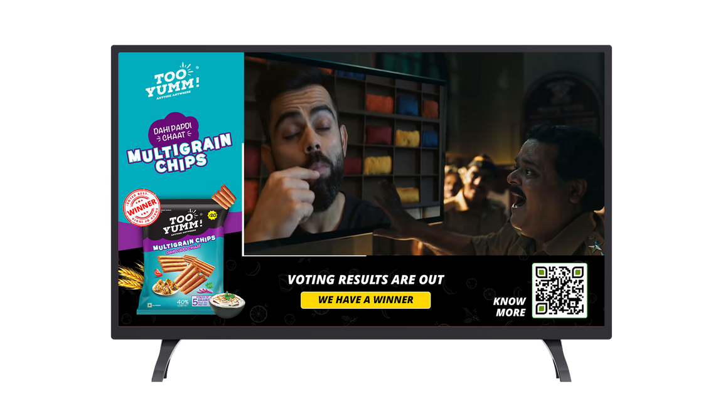
Remote-Based Integration
CTV
For Option Configuration, Contextual Carousel, Product Features
CPMs Starting From INR 380
Clickable CTAs via Remote
Let viewers interact directly using their TV remote, exploring festive deals, selecting product options etc.
Seamless Big-Screen Browsing
Native browsing experience ideal for catalogues, offers, or product highlights during high-intent festive moments
Discovery > Action
Drive real-time decisions & deeper engagement through intuitive, user-led interaction
Low Friction, High Intent
Nudging festive shoppers toward action for product features, variants and gift guides
Click Here for a Working Mockup
*The above link is only for representation purposes and should serve only as a reference.

Slide 7
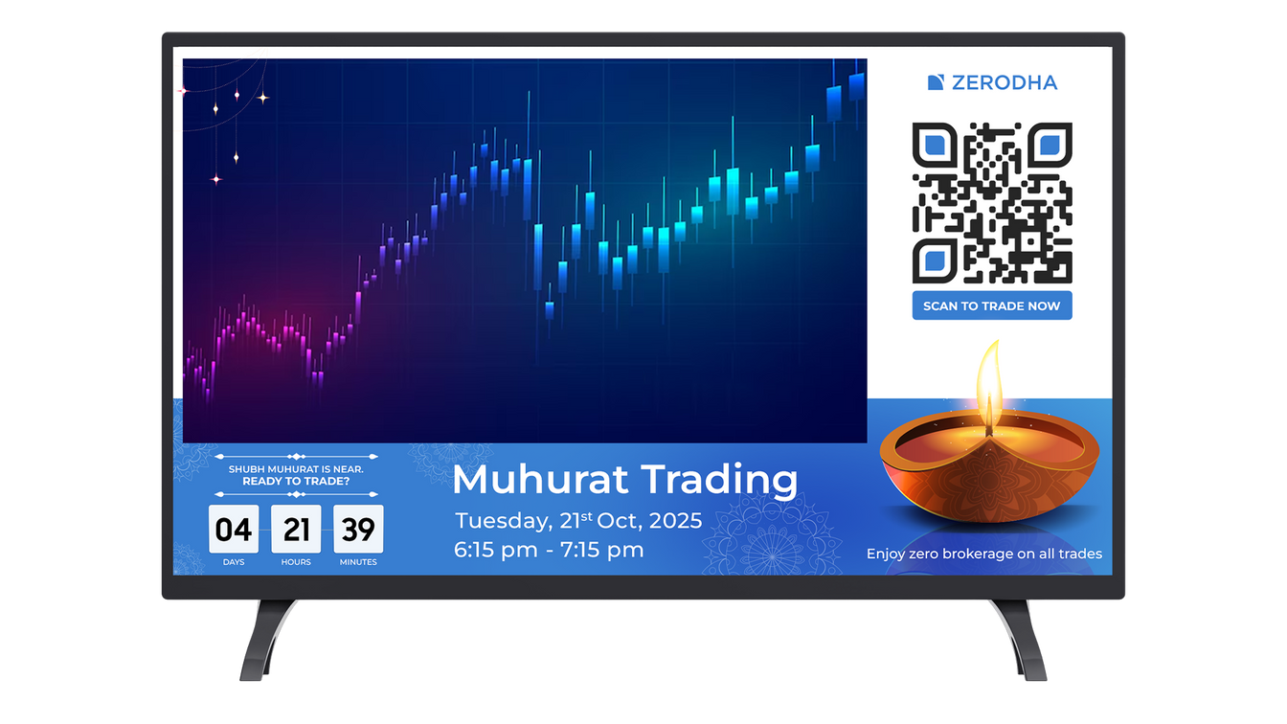
Countdown-Based
CTV
For Sales/Product Launch
CPMs Starting From INR 380
Live Countdown Timer
Showcases a dynamic, real-time countdown leading up to your launch or offer
QR Code Integration
Let viewers scan to set reminders, add to calendars, or explore pre-launch exclusives
Festive Urgency, Done Right
Perfect for Diwali drops, limited-time offers, or big unveilings, driving FOMO
Lean Into Attention
Turns passive viewing into active engagement, capturing interest when audiences are receptive
Click Here for a Reference Working Mockup
*The above link is only for representation purposes and should serve only as a reference.

Slide 8
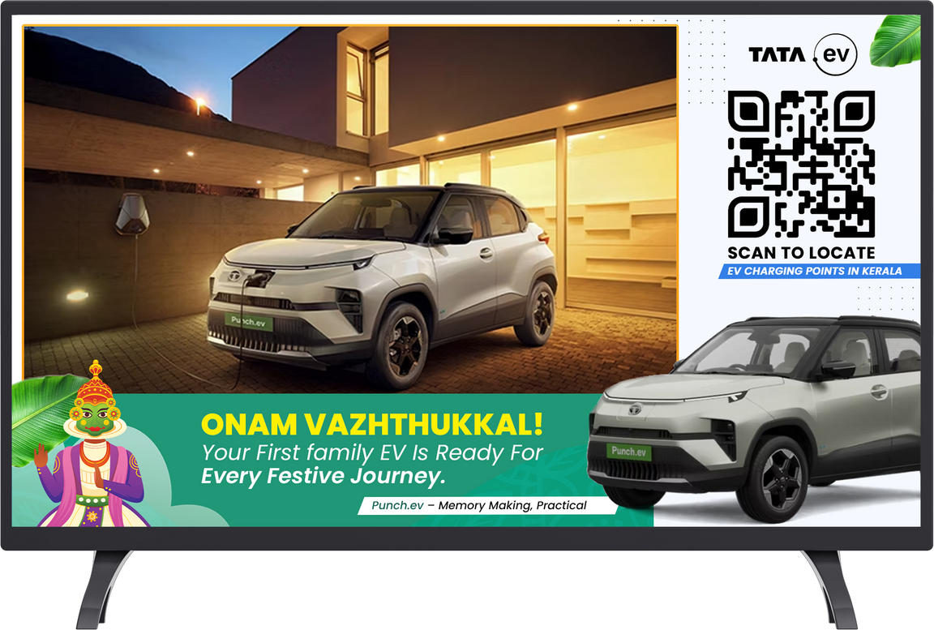
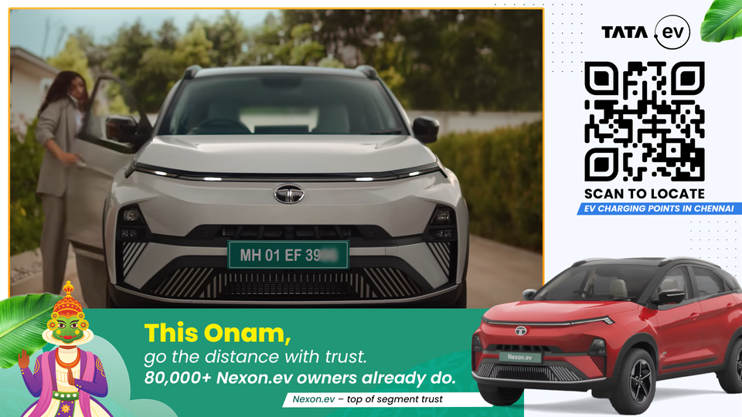
Dynamic Creative Optimisation
CTV
For Affinity, AQI, Temperature, Weather, Stock Market Based Customisation
CPMs Starting From INR 380
Smart Festive Personalisation
Tailor messages in real-time, crafting festive stories that
feel personal
Context That Clicks
Trigger creative adapts using live signals like AQI, temperature, or weather
Realtime Sentiment Sync
React to cultural, emotional, or market moments, customise based on mood-based content cues
One Campaign. Infinite Variations.
Deliver festive storytelling at scale, dynamic headlines, visuals, & offers that adjust based on who’s watching & when
Click Here for a Reference Working Mockup
*The above link is only for representation purposes and should serve only as a reference.

Slide 9
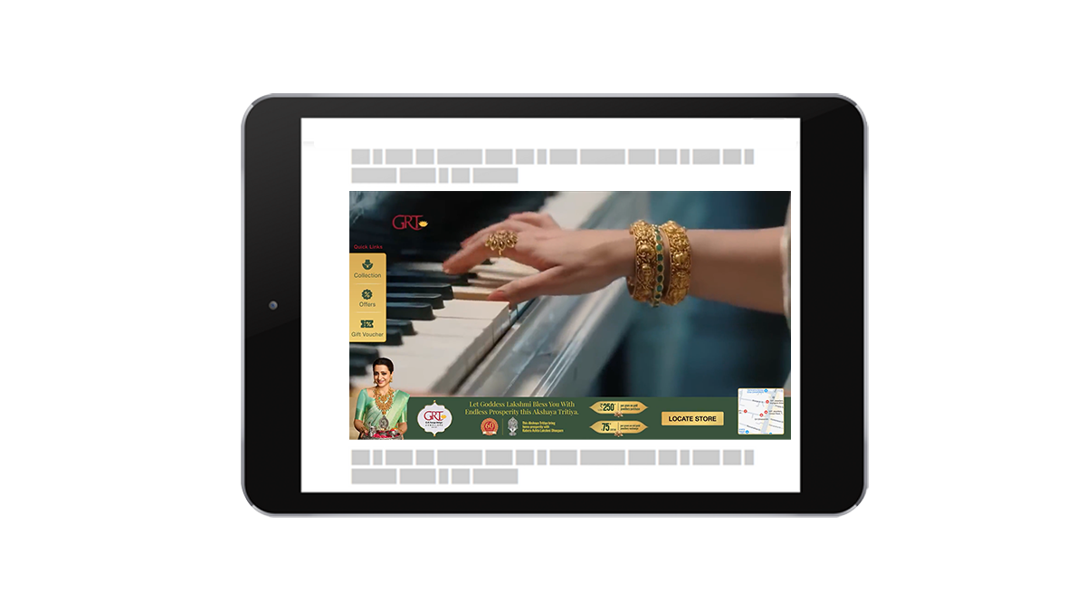
Advanced OLV
OLV
For Showcasing Options, Features & Festive Value; Driving Footfall
CPMs Starting From INR 165
Interactive Drawer Overlay
Adds clickable options within the video frame, pushing viewers toward high-intent actions like exploring offers or scheduling visits.
Location-Driven CTA
Integrates Google Maps redirection for a seamless transition from screen to store, ideal for driving real-world outcomes.
Designed for Lower-Funnel Impact
Moves viewers from interest to in-person interaction, boosting footfall, trials, or offline conversions during festive peaks.
Click Here for a Reference Working Mockup
*The above link is only for representation purposes and should serve only as a reference.

Slide 10
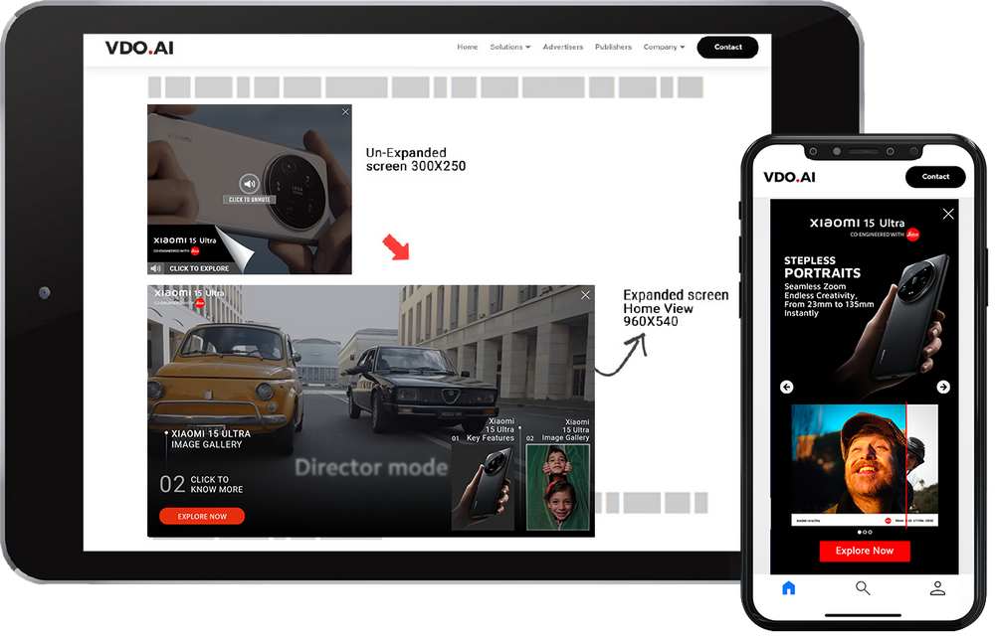
In-Frame Expandable
OLV
For Layered Storytelling
CPMs Starting From INR 165
Visual Expansion
Starts as a video and expands within the frame to reveal product highlights, features, or festive offers, without disrupting the viewing experience.
Seamless Interactivity
Lets viewers explore more, click through, or shop directly, blending storytelling with a low-friction path to conversion.
Designed for Deeper Discovery
Combines creativity and utility, perfect for showcasing multi-SKU products, tech specs, or festive combos in a single immersive format.
Click Here for a Reference Working Mockup
*The above link is only for representation purposes and should serve only as a reference.

Slide 11
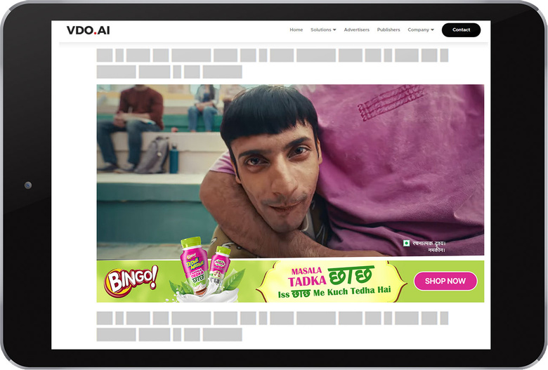
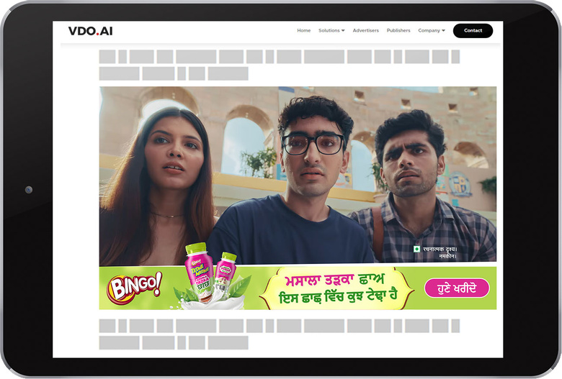
DCO for OLV Ads
OLV
For Hyper-Personalised, Micro-Targeting
CPMs Starting From INR 165
Dynamic Messaging at Scale
Customise creatives in real time based on user affinity, geo, weather, or behaviour, delivering the most relevant message, every time.
Interactive Elements Built In
Add clickable CTAs, product carousels, or overlays to turn passive views into active exploration.
Seamless Redirection
Effortlessly guide users to landing pages, product pages, or app installs, all within the video experience.
Click Here for a Reference Working Mockup
*The above link is only for representation purposes and should serve only as a reference.

Slide 12
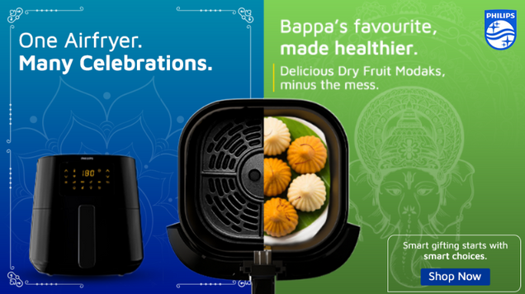
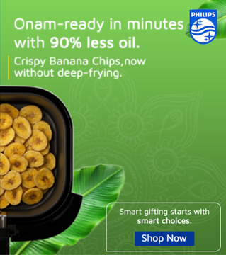
In-Scroll Display
Display
For Dynamic Content, Surprise Discovery, Mutiple Messaging
CPMs Starting From INR 140
Scroll-Activated Visuals
As users scroll, one half of the banner stays fixed while the other transforms, revealing features, offers, or festive moments in sync with user movement.
Layered Brand Messaging
Deliver a narrative in stages, from problem to solution, tease to reveal, or feature to CTA
Built for Attention in Motion
Designed to surprise and engage mid-scroll, turning casual browsing into branded discovery without interrupting the user experience.
Click Here for a Working Mockup
*The above link is only for representation purposes and should serve only as a reference.

Slide 13
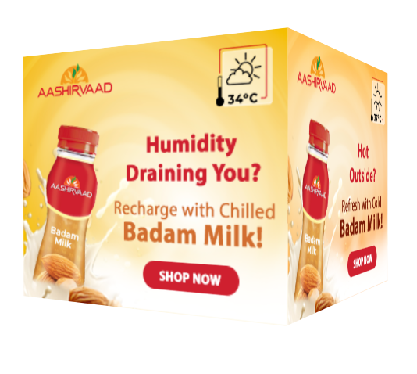
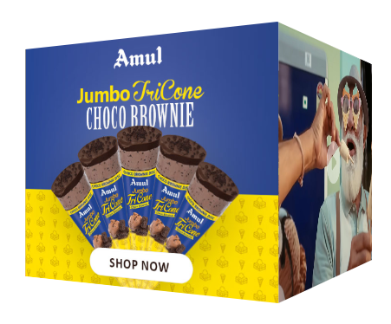
3D Cube
Display
For Highlighting Multiple SKUs, Features, or Offers
CPMs Starting From INR 140
Multi-Faced Messaging
Rotate between different visuals, offers, or product shots; each face of the cube tells a new part of the story.
Quick & Mobile-Friendly
Designed for smooth performance across devices without compromising visual appeal or engagement.
Festive-Ready Storytelling
Perfect for highlighting combos, gifting ranges, or multi-SKU showcases.
Click Here for a Reference Working Mockup
*The above link is only for representation purposes and should serve only as a reference.

Slide 14



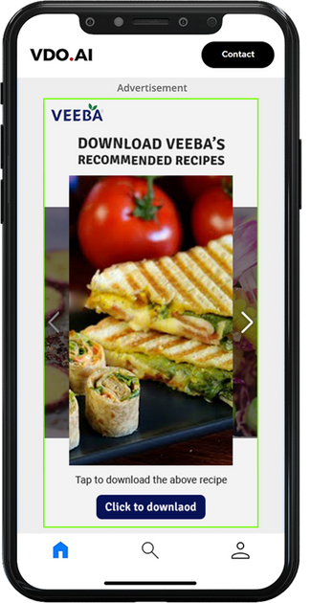
Execution Strategy
Identify & impress
Options like behavioral, contextual, in-market and 3rd party audience segments from major DMPs can assist in reaching out to the core TG. Additionally our custom creative units can deliver the wow factor!
Trusted delivery
mediums
100% brand safety layering with strategic ad placements on major CTV apps can help build an efficient and result-oriented campaign
Retargeting for more than just awareness
Standard Display ad formats to drive maximum brand consideration and follow through with more customized messaging to drive conversions

Slide 15

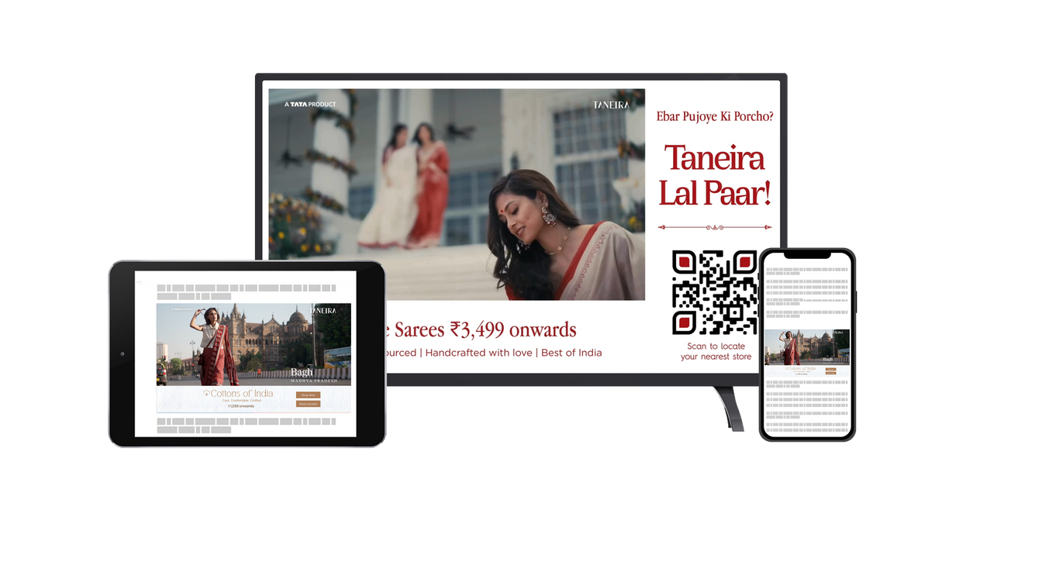
Video Completion Rate
CTV: 93%+ VCR (vs. 85% industry standard)
OLV: 70%+ (exceeding industry standard average of 55%)
CTR Performance
OLV: 0.2%+ (vs. 0.1% industry standard)
Display: 0.3%+ (vs. 0.2% industry standard)
Precision Targeting
Delivered on lifestyle and fashion-focused platforms to ensure contextual relevance.
Targets high-intent users and premium shoppers through smart filters.
Guaranteed Delivery & Measurable Impact
Every campaign comes with minimum impression commitment to ensure promised visibility.
Access real-time performance through live dashboards for transparent, data-driven optimisation.
Festive Wins,
Delivered.
Powerful Format Offerings
Connected TV: Interactive, screen-dominant storytelling with QR-led actions
Online Video: High-quality storytelling and product integration
Mobile Rich Media: Immersive, hands-on formats that drive brand recall
SCROLL SE SALE TAK

Slide 16


REDEFINING CUSTOMER EXPERIENCES
THANK YOU!
hello@vdo.ai

